Slide 1


Slide 2

Interfaces lack instance variables,and their methods are declared without any body.
Once it is defined, any number of classes can implement an interface.
One class can implement any number of interfaces.

Slide 3

To implement an interface, a class must create the complete set of methods defined by the interface.
Each class is free to determine the details of its own implementation.
By providing the interface keyword, Java allows you to fully utilize the “one interface, multiple methods” aspect of polymorphism.

Slide 4

General form of an interface:
access interface name
{
return-type method-name1(parameter-list);
return-type method-name2(parameter-list);
type final-varname1 = value;
type final-varname2 = value;
// ...
return-type method-nameN(parameter-list);
type final-varnameN = value;
}

Slide 5
Variables can be declared inside of interface declarations. They are implicitly final and static, meaning they cannot be changed by the implementing class. They must also be initialized with a constant value. All methods and variables are implicitly public if the interface, itself, is declared as public.
E.g.
interface Callback
{
void callback(int param);
}

Slide 6

The general form of a class that includes the implements clause looks like this:
access class classname [extends superclass]
[implements interface [,interface...]]
{
// class-body
}

Slide 7

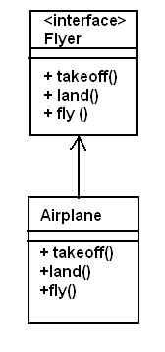
The Flyer interface and
Airplane Implementation
public interface Flyer {
public void takeoff();
public void land();
public void fly();
}

Slide 8
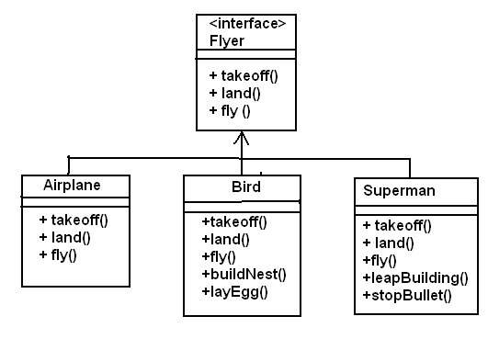
Multiple Implementation of the Flyer Interface

Slide 9
The following Describe the Bird class:-
public class Bird Extends Animal implement Flyer
{
public void takeoff()
public void land()
public void fly()
public void buildNest()
public void layEggs()
public void eat()
}

Slide 10
// One interface can extend another.
interface A
{
void meth1();
void meth2();
}
// B now includes meth1() and meth2() -- it adds meth3().
interface B extends A
{
void meth3();
}

Slide 11
/ /This class must implement all of A and B
class MyClass implements B
{
public void meth1()
{
System.out.println("Implement meth1().");
}
public void meth2()
{
System.out.println("Implement meth2().");
}
public void meth3()
{
System.out.println("Implement meth3().");
}
}

Slide 12
class IFExtend
{
public static void main(String args[])
{
MyClass ob = new MyClass();
ob.meth1();
ob.meth2();
ob.meth3();
}
}

Slide 13

/* D:\Program>javac IFExtend.java
D:\Program>java IFExtend
Implement meth1().
Implement meth2().
Implement meth3().
*/

